Slide 1
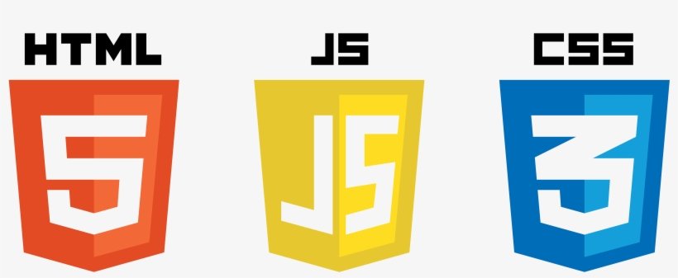


CSE 4165:
Web Programming
Mahmudul Hasan

Slide 2



What is Web Programming?
The process of creating websites and web applications that run on the internet.
Includes both front-end (HTML, CSS, JS) and back-end (PHP, MySQL) development.
Browser
Database
Server

Slide 3
Lab Contents
Week 1-3: HTML
Week 4-5: CSS
Week 6-7: JavaScript
Week 8-10: PHP
Week 11-12: MySQL

Slide 4
How You’ll Be Graded
Attendance: 5
Project with Viva: 35
  Prototype Presentation (Week 3): 10
  Interim Demonstration (Week 8, 50% of Project): 10
  Final Demonstration (Week 12, 100% of Project + Viva): 15
Midterm Exam: 30
Final Exam: 30

Slide 5
Project Details
Each group must be of 4 members.
Project will be assigned by me.
Prototype - PowerPoint /Canva/Figma
Interim - 50% Functional
Final demo - Complete Project

Slide 6
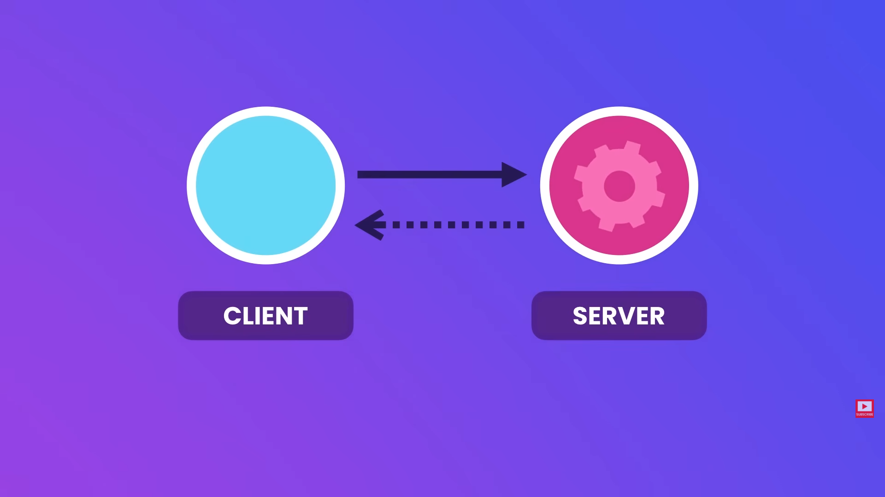
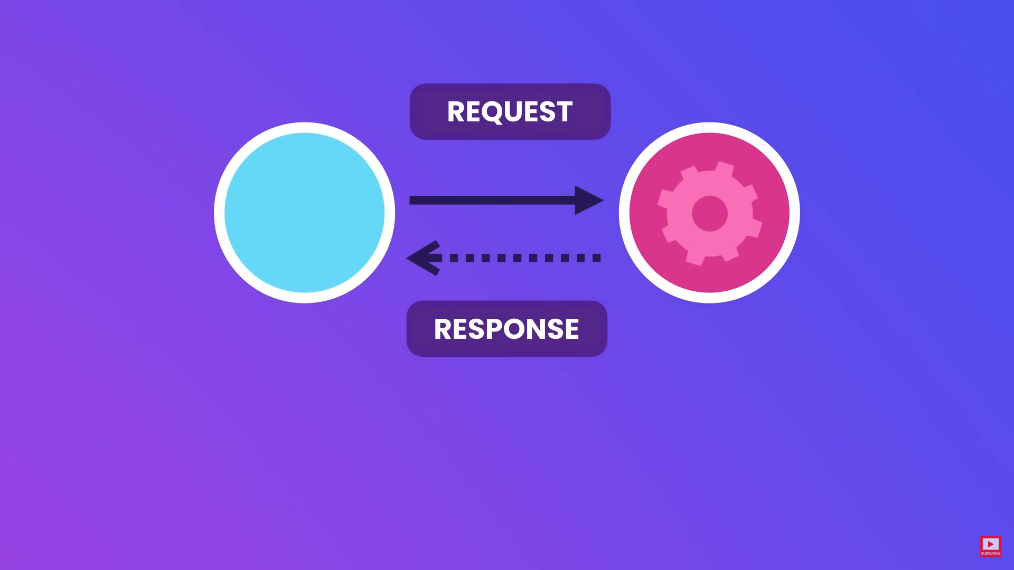
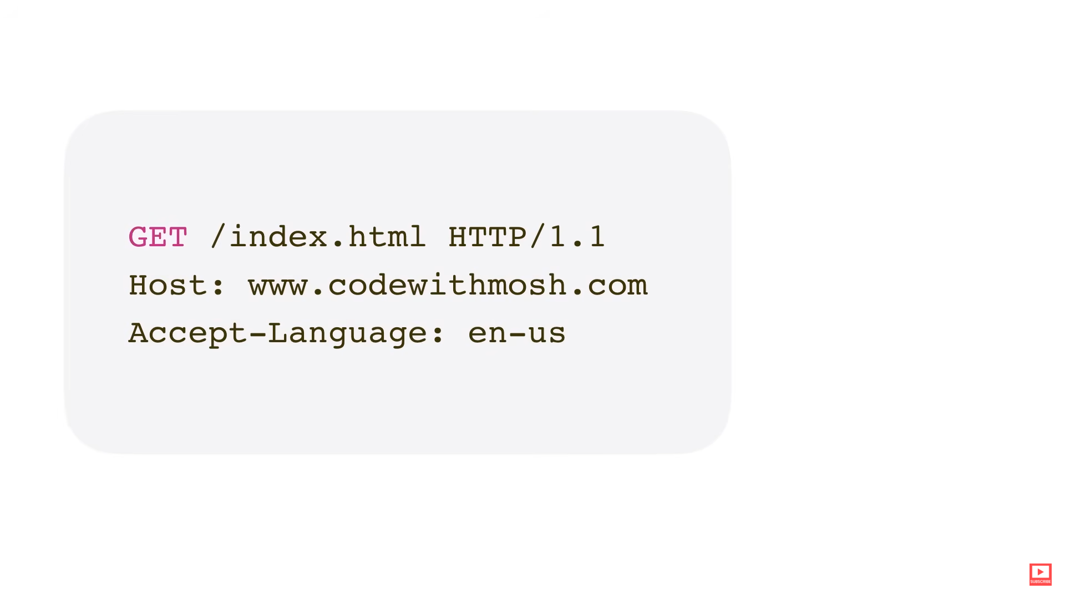
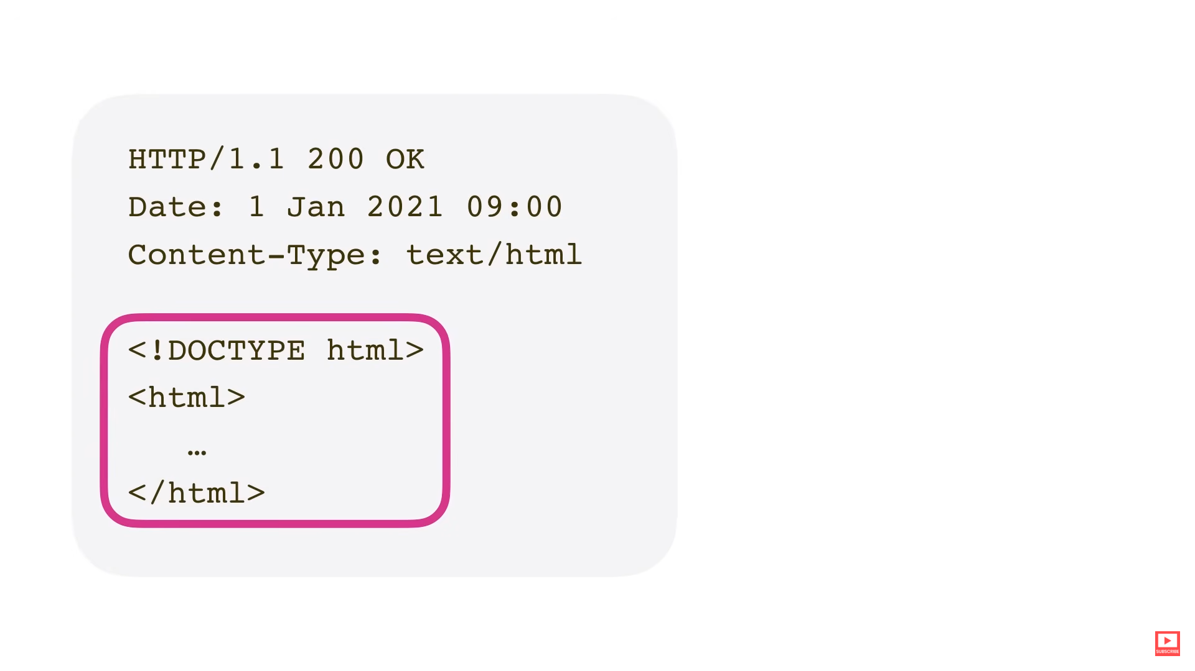
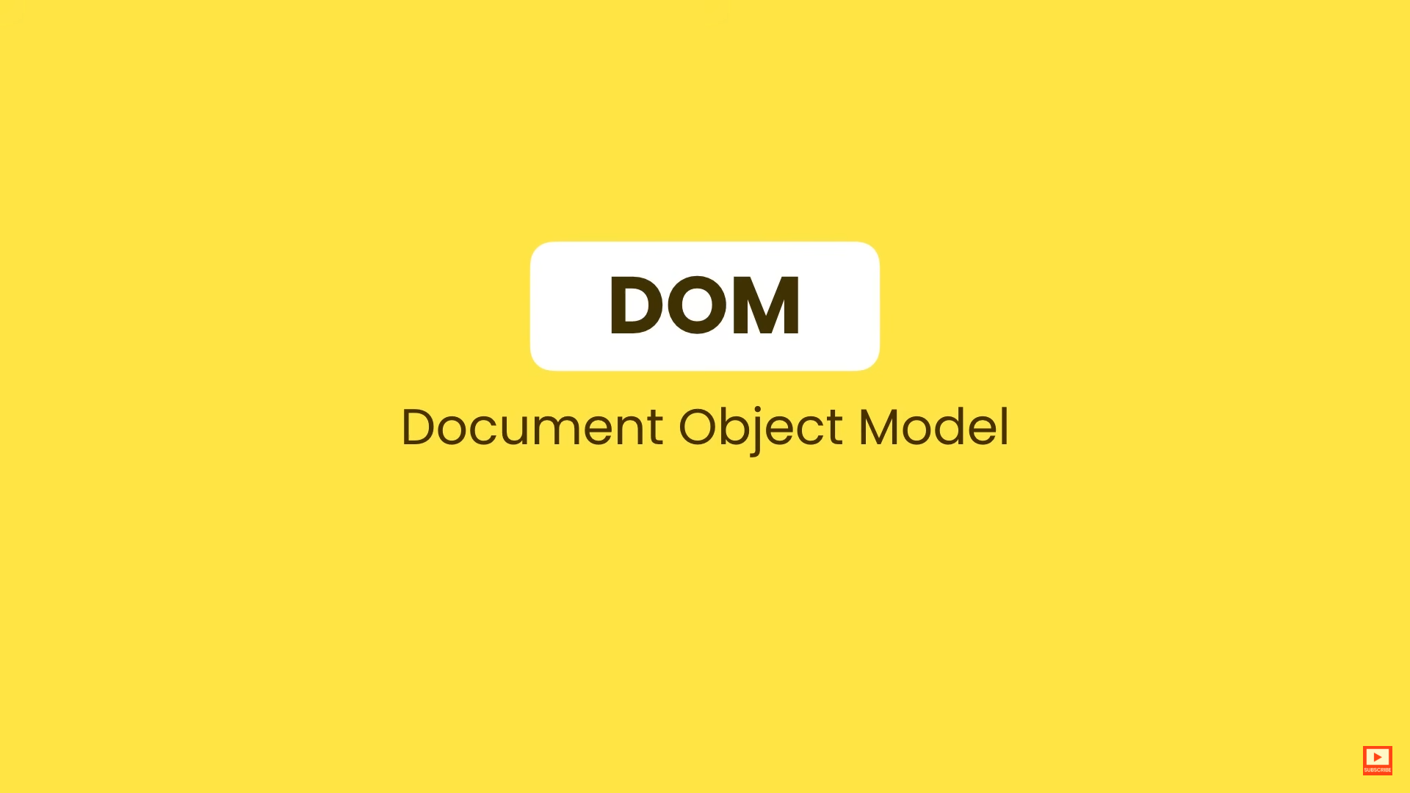
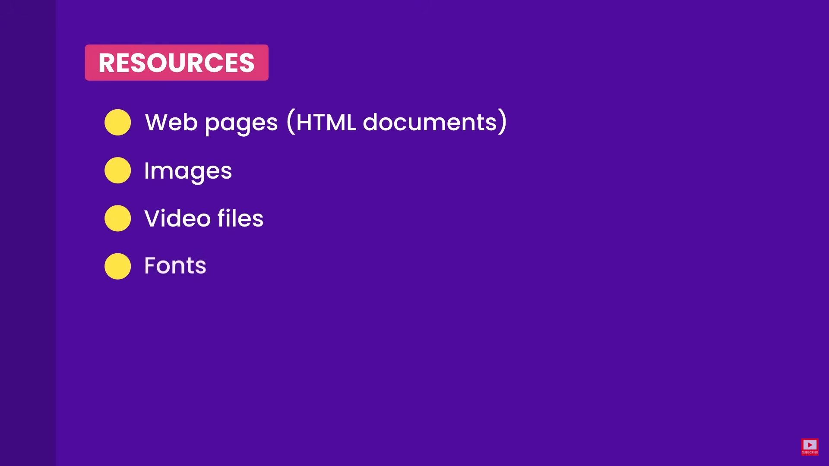
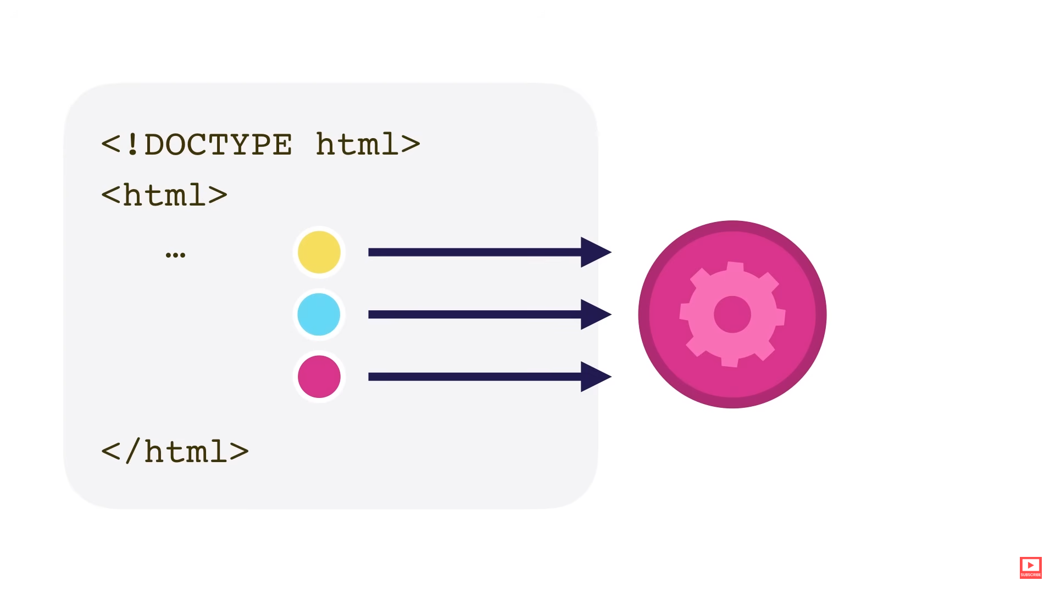
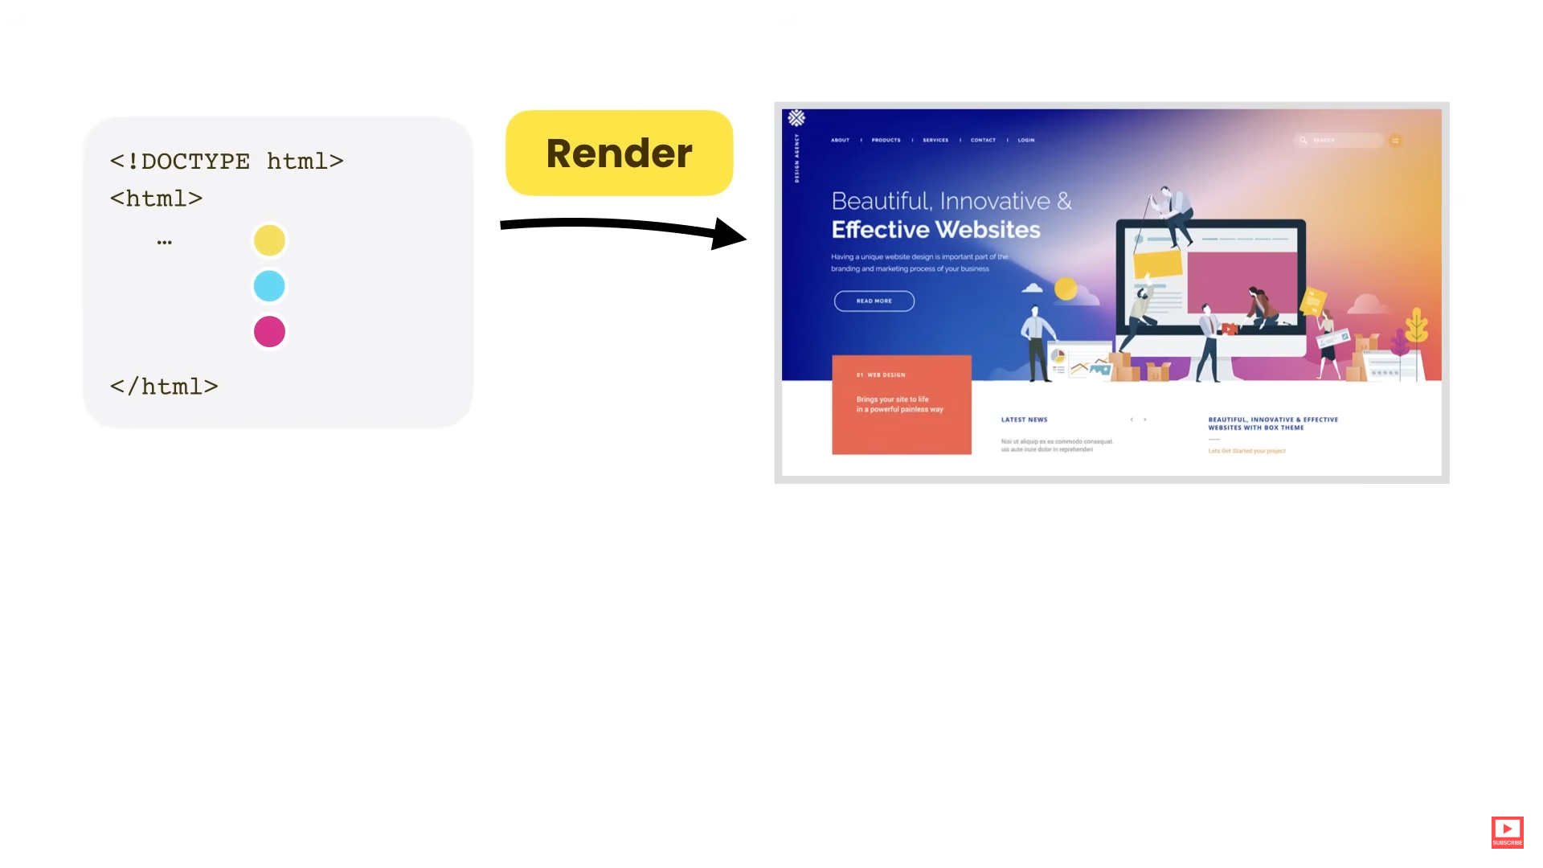

Slide 7
HTML
What is HTML?
  HyperText Markup Language.
  Backbone of all websites.
A markup language is a set of markup tags
The tags describe document content
Used to structure web content (text, images, links, forms).
HTML documents contain HTML tags and plain text
HTML documents are also called web pages
HTML = Structure → CSS = Style → JS = Behavior.

Slide 8
HTML TAGS
HTML tags are keywords (tag names) surrounded by angle brackets like <html>
HTML tags normally come in pairs like <b> and </b>
Start and end tags are also called opening tags and closing tags

Slide 9
Web Browsers
A web browser (Google Chrome, , Firefox) reads HTML documents and display them as web pages.
The browser does not display the HTML tags, but uses the tags to determine how the content of the HTML page is to be presented/displayed to the user
    Internet Explorer

Slide 10
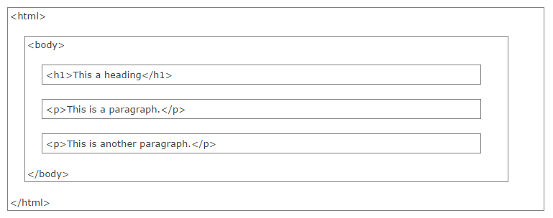
HTML PAGE STRUCTURE
HTML Codes are wrapped in the <html> </html> tag.

Slide 11
HTML <head>
The <head> section contains metadata — information about the webpage, not shown on the page itself.
Importance:
  Defines document settings, styles, scripts, and metadata.
  Includes tags like <title>, <meta>, <link>, and <script>.
  Essential for SEO, browser configuration, and overall webpage structure.

Slide 12
The HTML <title> Element
The <title> element:
  defines a title in the browser toolbar
  provides a title for the page when it is added to favorites
  displays a title for the page in search-engine results

Slide 13
Scary Stuff
<meta charset="UTF-8">
Sets the character encoding for the webpage to UTF-8.
UTF-8 supports most languages and symbols (e.g., English, Bengali, Arabic, emojis).
Ensures text is displayed correctly — without weird question marks (�).
<meta name="viewport" content="width=device-width, initial-scale=1.0">
Tells the browser how to control the page’s dimensions and scaling on different devices
Enables responsive design.
Makes sure your page adjusts to fit different screen widths.
Notes:
width=device-width → sets the width to the screen’s width.
initial-scale=1.0 → sets the zoom level to 100%.

Slide 14
HTML BASICS
HTML Headings
HTML headings are defined with the <h1> to <h6> tags.
Example
<h1>This is a heading</h1>
<h2>This is a heading</h2>
<h3>This is a heading</h3>

Slide 15
HTML BASICS
HTML Paragraphs
HTML paragraphs are defined with the <p> tag.
Example
<p>This is a paragraph.</p>
<p>This is another paragraph.</p>
HTML Line Breaks
Use the <br> tag if you want a new line.
The <br> element is an empty HTML element. It has no end tag.
HTML Comment
<!-- This is a comment -->

Slide 16
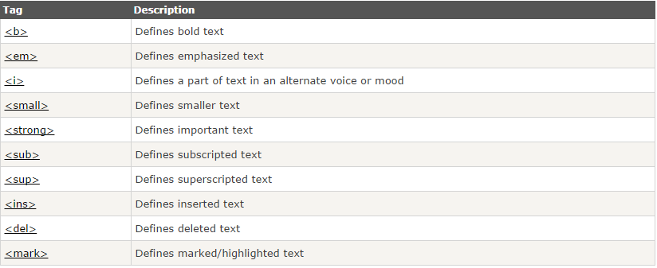
HTML Text Formatting

Slide 17
HTML Tables
Defined with the <table> tag.
A table is divided into rows <tr> tag
Each row is divided intro data cells <td> tag.
  A <td> tag can contain text, links, images, lists, forms, other tables, etc

Slide 18
HTML Input Element
The <input> element is used to select user information.
An <input> element can be of type text field, checkbox, password, radio button, file, submit button, and more.

Slide 19
HTML Element - <select>
Used to let users choose one option (or multiple if allowed).
<select>
<option>Bangladesh</option>
<option>United States</option>
<option>Japan</option>
</select>
Add multiple inside <select> to allow multiple selections.
  E.g <select multiple>
Notes:
Selected - This makes the option the default visible choice when the page first loads
Disabled - This makes the option unclickable — users can’t select it once they open the dropdown.
Hidden - This hides the option from the dropdown list when it’s opened

Slide 20
Resources
https://www.w3schools.com/html/
ELMS

